Slide 1

How To Print A Bill of Lading from
MY OOCL CENTER (MOC)

Slide 2
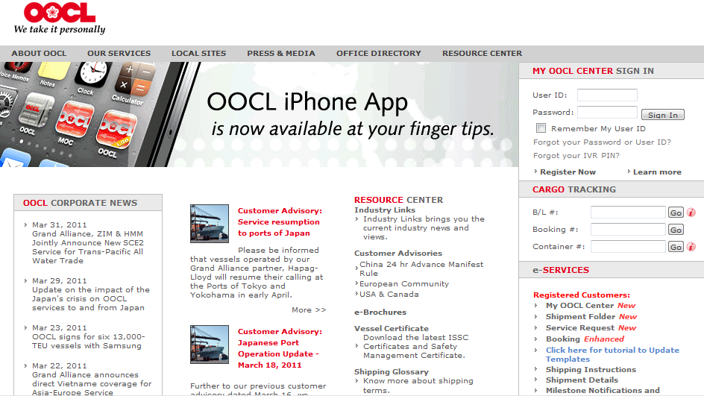
Sign onto MOC
B/L View & Print
Search B/L
Select Stationary
Print
“Type in your user ID and password”
User ID
password
“If you do not have one, click Register Now”

Slide 3
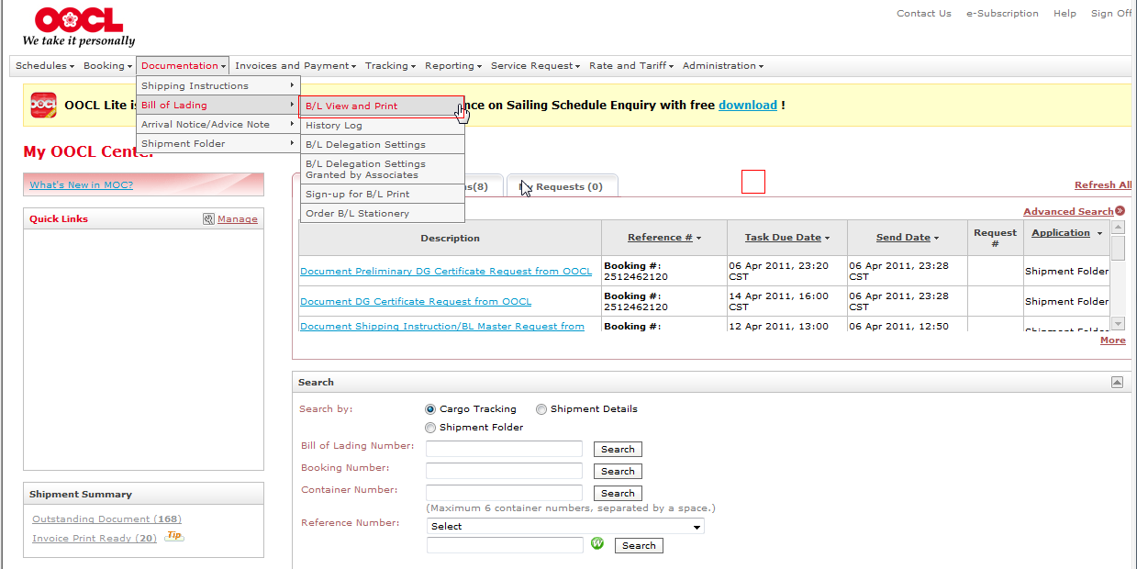
Sign onto MOC
B/L View & Print
Search B/L
Select Stationary
Print
“Click on Bill of Lading View and Print in order to access Bill of Lading search options”
“From the menu bar select Documentation”
“Followed by Bill of Lading”
Notes:
Script: “”

Slide 4
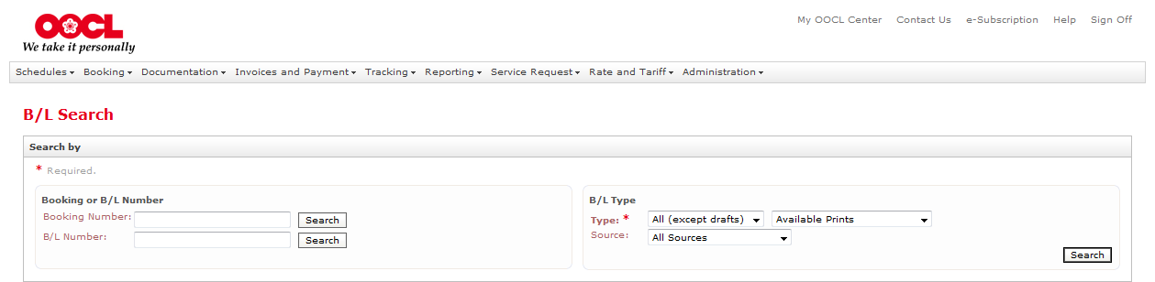
Sign onto MOC
B/L View & Print
Search B/L
Select Stationary
Print
2508401580
“To print a single BL, input the booking or bill of lading number and click Search.
Note – only the numeric portion of the Bill of Lading number is required to be input.”

Slide 5
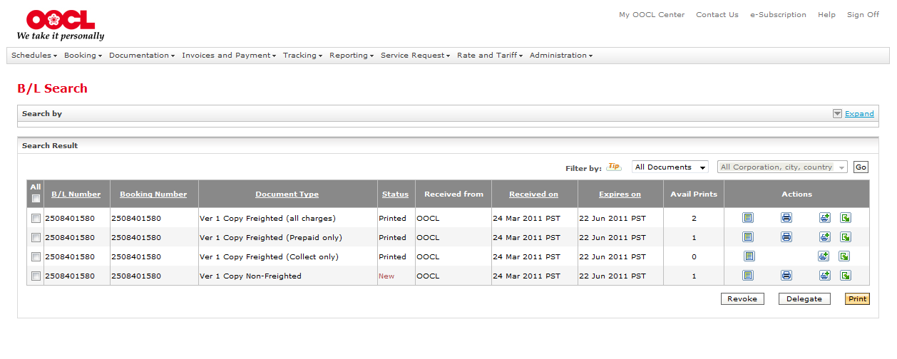
Sign onto MOC
B/L View & Print
Search B/L
Select Stationary
Print
“Review the type of Bill of Lading you wish to print, and select the corresponding check box. Note only one type of Bill of Lading may be printed at a time as you can only select one type of Bill of Lading Print Paper – OOCL Stationary or Plain Paper”
“Select either the Print icon under Actions or the Print button in the bottom right corner of your screen.”
Notes:
Script

Slide 6
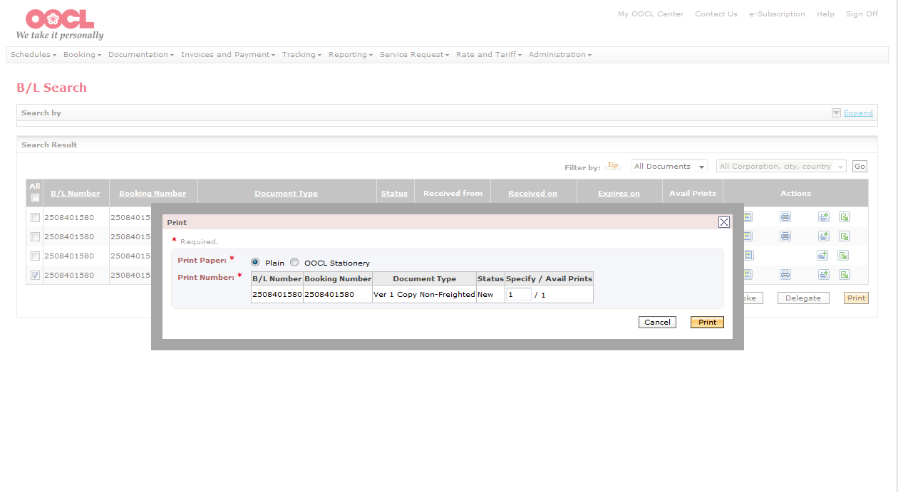
Sign onto MOC
B/L View & Print
Search B/L
Select Stationary
Print
“Dependent on type selected, your bill of lading will be printed on OOCL stationery, or plain paper.”
“Select the type of Print Paper, then click on “Print” “.

Slide 7
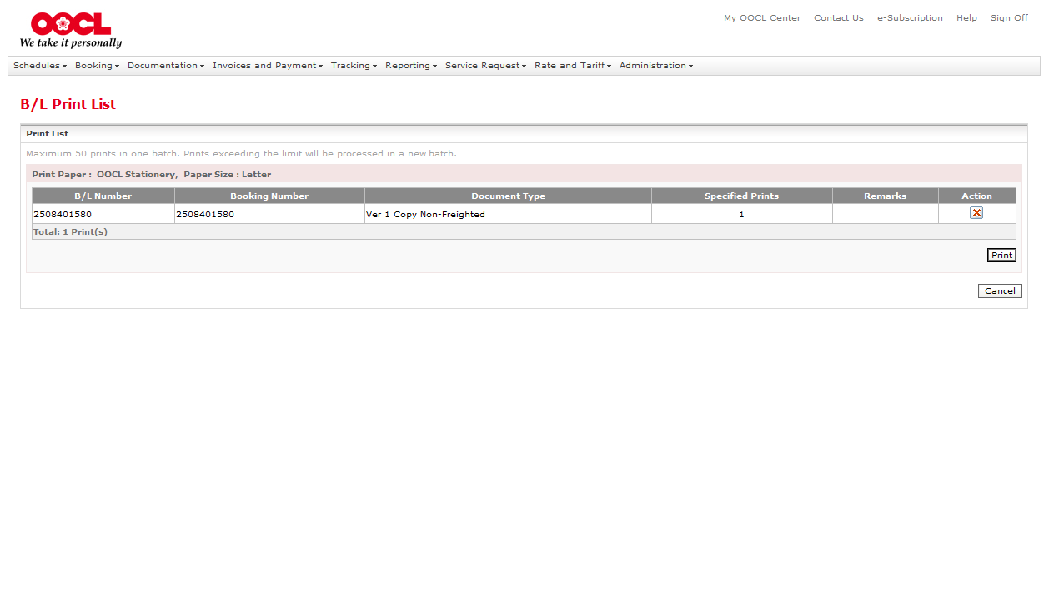
Sign onto MOC
B/L View & Print
Search B/L
Select Stationary
Print
“On the Bill of Lading Print List screen, again select Print.”

Slide 8
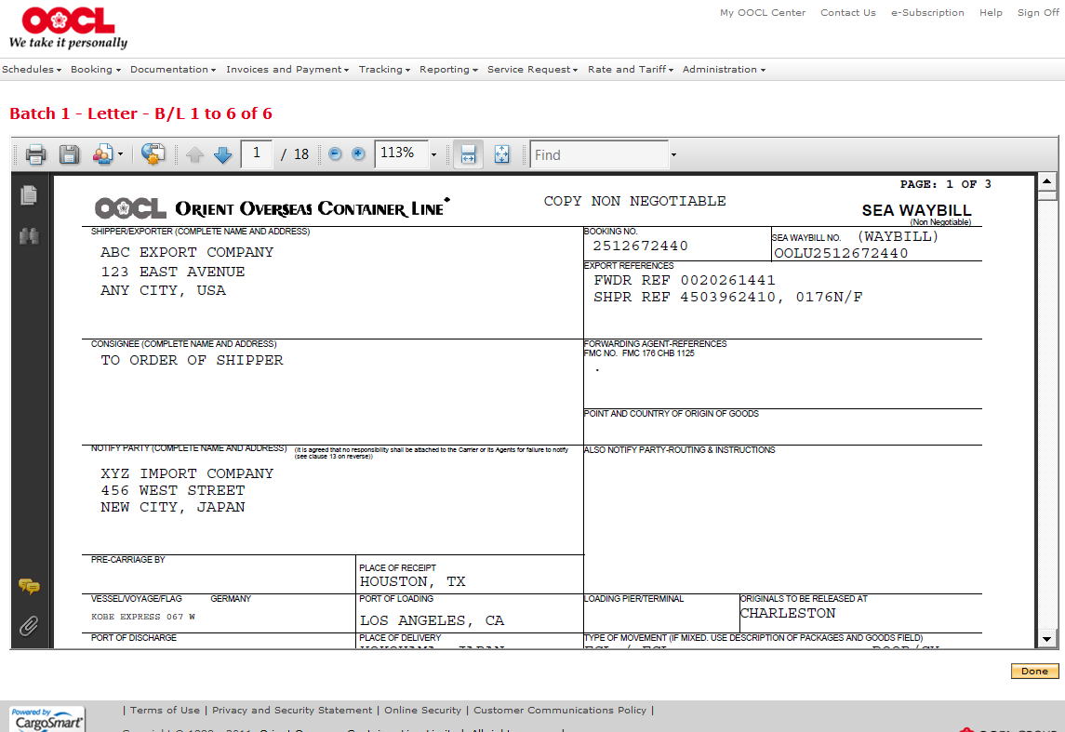
Sign onto MOC
B/L View & Print
Search B/L
Select Stationary
Print
“A PDF image of your Bill of Lading will appear. Select the printer icon in the upper left corner in order to complete printing your Bill of Lading.”

Slide 9
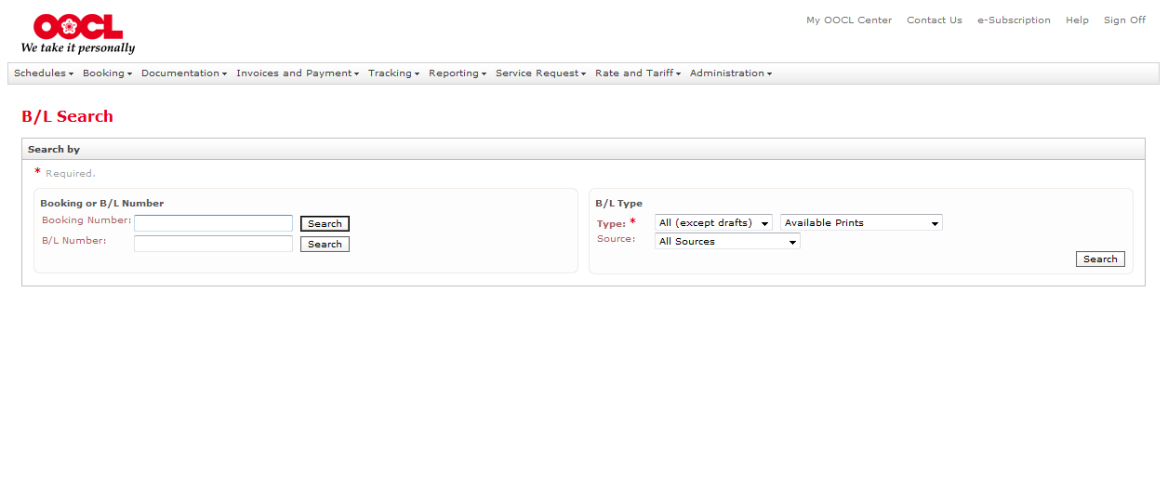
“If you have multiple bills of lading to print at one time, you can use the B/L type search feature. Select the type from the B/L Type drop down box.”
“Two commonly used types are:
All (except drafts) – this includes all Original BLs, non-negotiable copies, and Sea Waybills that are completed, approved and ready for printing.
The other commonly used type is Draft - these are B/Ls that are ready for your review and approval prior being set up for release.
Click Search”
Notes:
Script

Slide 10
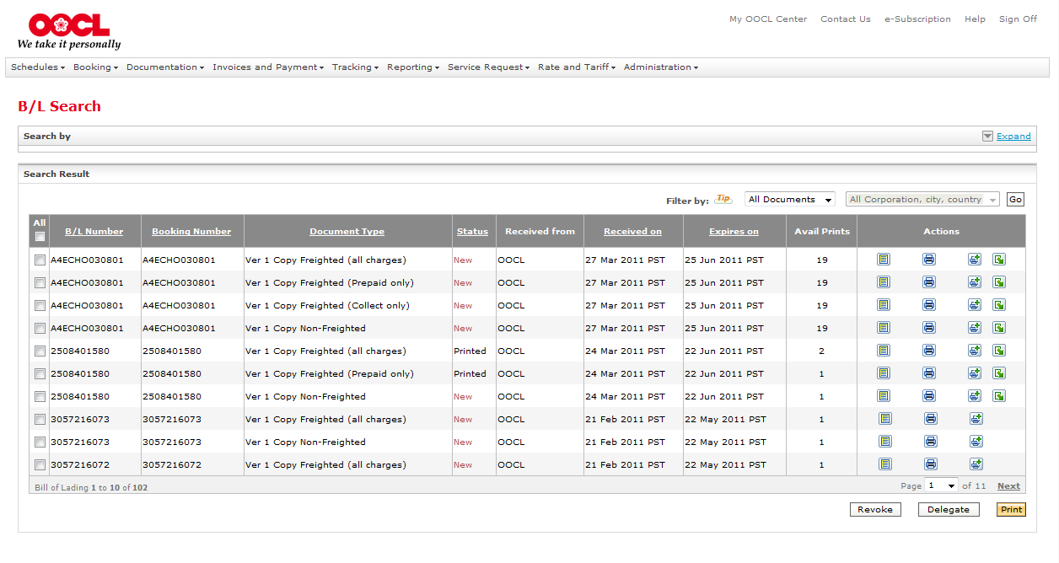
“Select the bills of lading that you want to print or select All. Please note only one type of Bill of Lading may be printed at one time and you may only select one type of Bill of Lading Print Paper – OOCL Stationary or Plain Paper.
Click Print”

Slide 11
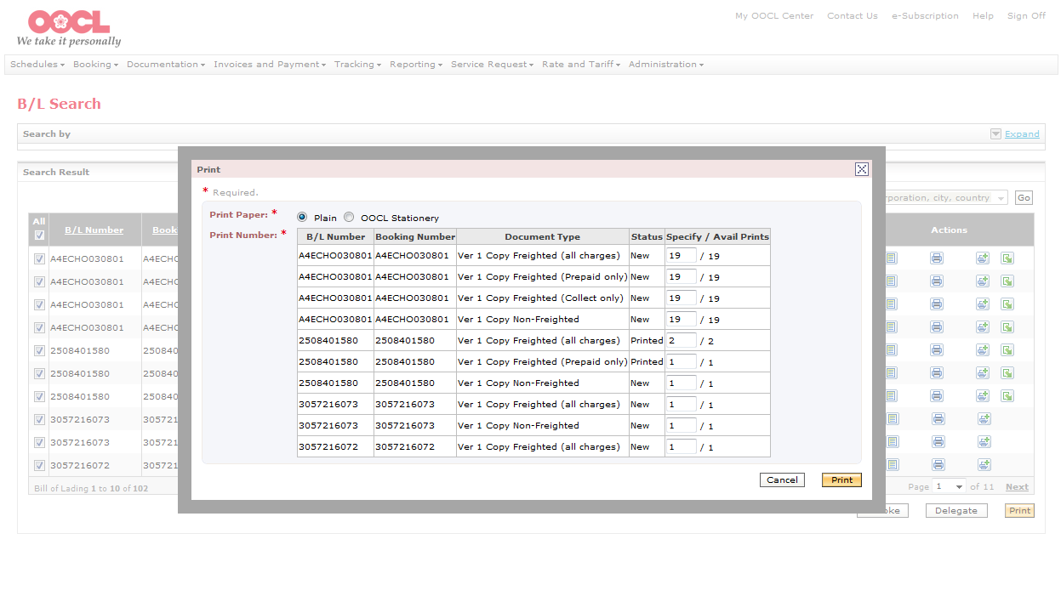
“Dependent on type selected, your bill of lading will be printed on OOCL stationery, or plain paper. Select the type of Print Paper, then click on “Print” “.

Slide 12
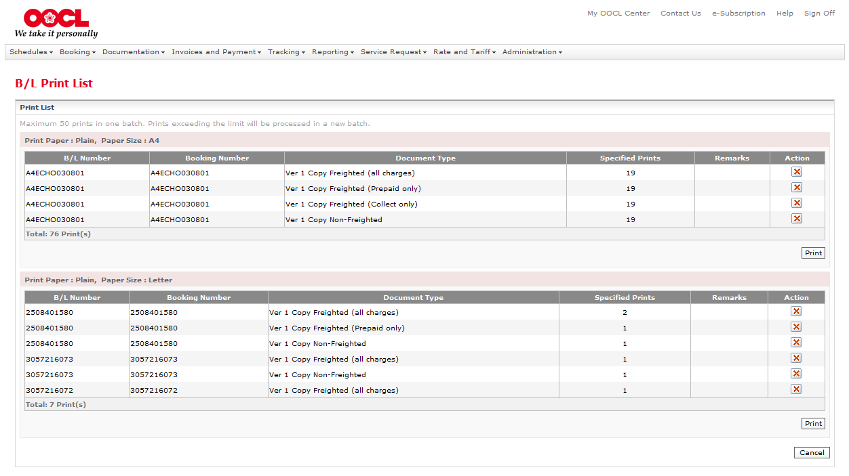
“On the Bill of Lading Print List screen, again select Print.”

Slide 13
“A PDF image of your B/L will appear. Select the printer icon to complete printing your Bill of Lading.

Slide 14
“We hope that you will enjoy using our Bill of Lading print feature available in My OOCL Center.”

