Slide 1
SOLAS VGM
– Regional Training
By RCD-WAG – May 2016

Slide 2
Agenda
SOLAS in brief
  e-Channels for Customers Submission
Implementation Strategy

Slide 3
What is SOLAS?
To improve safety in the supply chain, the International Maritime Organization (IMO) has made amendments to the Safety of Life at Sea (SOLAS) convention indicating that all shippers must comply with mandatory container weight verification requirements, or Verified Gross Mass (VGM), effective July 1, 2016.
IMO countries = 171 countries + 3 associate countries

Slide 4
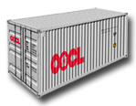

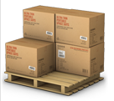
Basic Principles
“No VGM, No loading.” OOCL will comply with the SOLAS regulation and so any laden container without a VGM is not permitted to load onto the vessel.
Two permissible methods for weighing:
  Method 1: Weigh the packed container.
  Method 2: Weigh the cargo and other contents and add tare weight of the container.
Estimating weight is not permitted. Shipper must weigh or arrange for weighing of packed container or its contents.
Packed Container Weight
+
Cargo + Dunnage Weight
Tare on the plate

Slide 5
Regional Operation Model
Model A – Shipper submit VGM to Terminal via Carrier
Model B – Carrier as Cargo Operator submit VGM to Feeder operator / Vessel Operator

Slide 6
Model A - Shipper submit VGM to Terminal via Carrier
OOCL obtain VGM from Shipper and Submit VGM to Terminal
  OOCL provides VGM cutoff to Shipper or authorized “Booking party” representing the shipper.
  Shipper to maintain Copy of VGM as per local DG shipping rules.
  Booking Party ensures submission of VGM within cutoff to the shipping Line (via MOC, VERMAS, OOCL Lite Mobile App)
  OOCL approves or rejects VGM. Status available on MOC against Shipment.
  In case rejected by Line then shipper needs to take suitable action.
  OOCL submits VGM to the terminal.
  No VGM or Payload Exceeded – No Load.
Data Exchange
VGM Submission
Container Arrival/ Pre-Loading List/ VERMAS
Container Event
*BAPLIE
VGM Submission
1st VGM
@Gate-in
1st BAPLIE
2nd VGM
@Loading
Final BAPLIE
Booking
CT Arrives Terminal
Customer
VGM Cutoff
Terminal
VGM Cutoff
Vessel Sails
Container Arrival List/ VERMAS
or
Pre-Loading List
*When OOCL is the vessel operator

Slide 7
Model B – Carrier submit VGM to Feeder Operator
  OOCL obtain VGM from Shipper and Submit VGM to Feeder OperatorOOCL provides VGM cutoff to Shipper or authorized “Booking party” representing the shipper.
  Shipper to maintain Copy of VGM as per local DG shipping rules.
  Booking Party ensures submission of VGM within cutoff to the shipping Line (via MOC, VERMAS, OOCL Lite Mobile App)
  OOCL approves or rejects VGM. Status available on MOC against Shipment.
  In case rejected by Line then shipper needs to take suitable action.
  OOCL submits VGM to the Vessel Operator.
  No VGM or Payload Exceeded – No Load.
Data Exchange
VGM Submission
VGM Report
Container Event
Feeder VGM Cutoff
2nd VGM
@Loading
VGM Submission
1st VGM
@Gate-in
VGM Report
Booking
CT Arrives Terminal
Terminal VGM Cutoff
Vessel Sails

Slide 8
e-Channels for Customers Submission
Web Channel - My OOCL Center (MOC)
Mobile Apps - OOCL Lite
EDI

Slide 9



My OOCL Center (MOC) - Flow
MOC To-do List
Summary View(Available at Late May)
VGM Information Available in Shipment Folder/ Details
Customer
VGM Submission
Shipping Instruction with VGM
System Validation
Associate to Shipment
Parking Lot
Covered by IRIS4 Solution in later Slides
Carrier
Rejection Handling

Slide 10
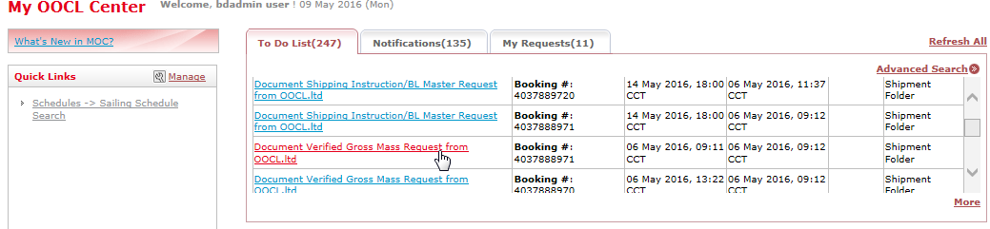
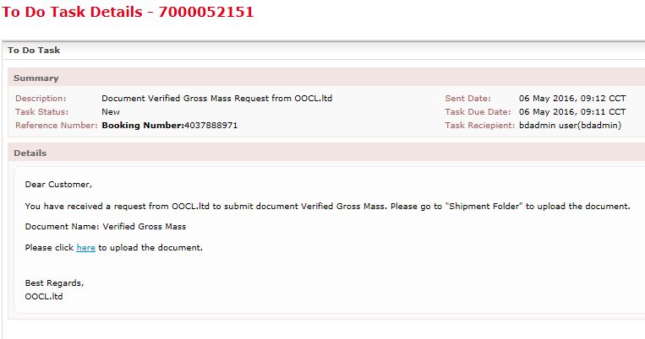
MOC MOC to-do list
Customer can identify the VGM requirement from the to do list

Slide 11
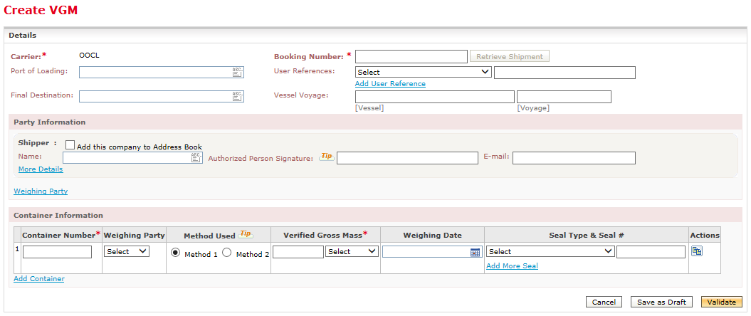
MOC Online VGM Submission
Online Submission Form
Preferred Method

Slide 12
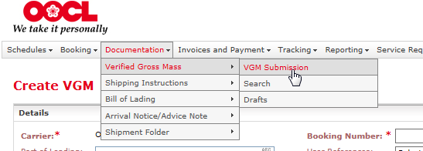
Access to VGM Submission Form
Tool Bar > Documentation > VGM Submission

Slide 13
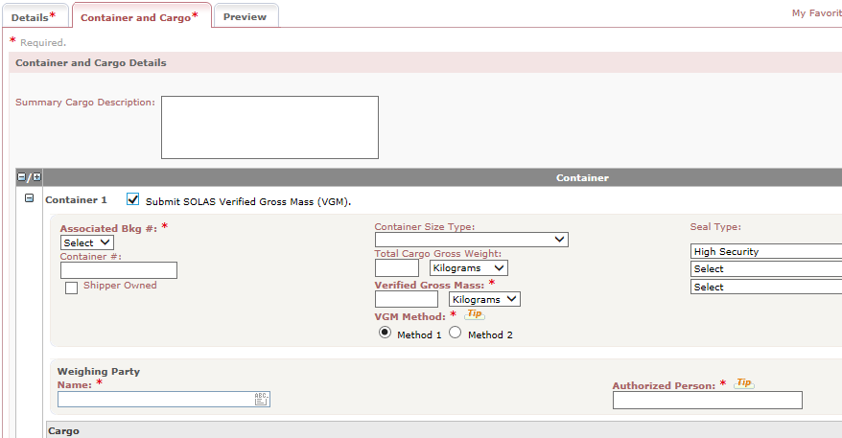
MOC Shipping Instruction
Submit VGM along with Shipping Instruction
Preferred Method

Slide 14
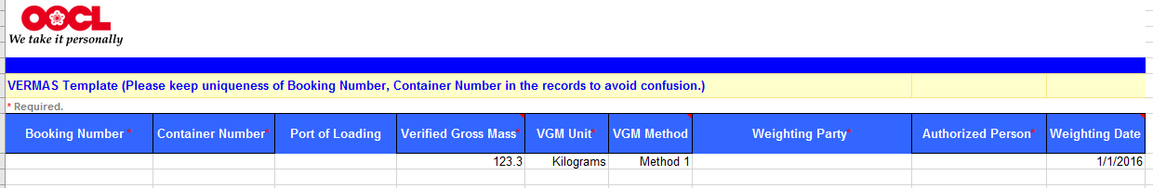
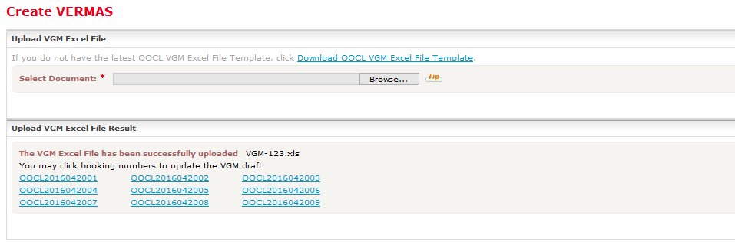
MOC Online Excel Batch Submission(Available at Late May)
Excel Format
Upload Excel
Preferred Method

Slide 15
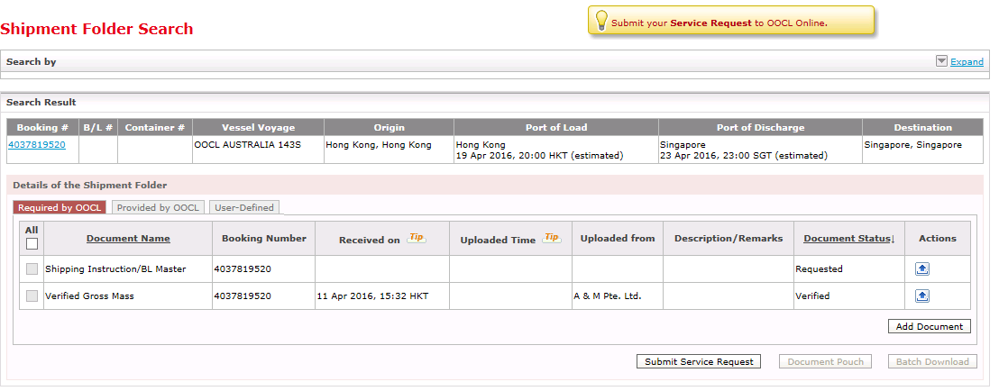
MOC Shipment Folder
VGM Required Document Status (at Booking Level)
  For e.g., VGM for any container has been verified will be under verified

Slide 16
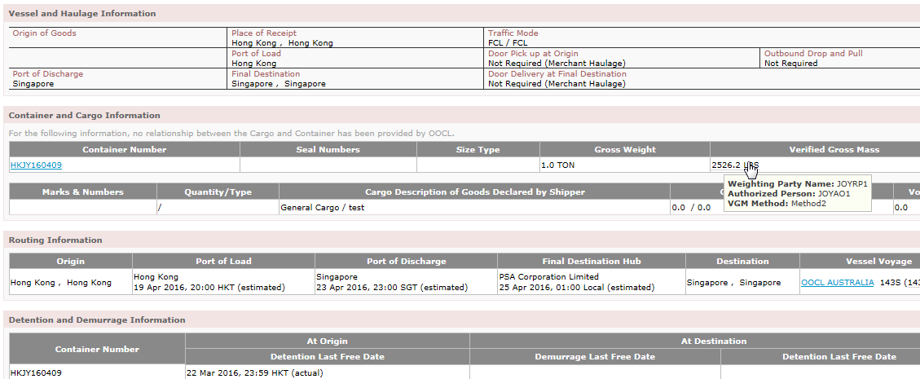
MOC Shipment Details
Customer could check all container VGM status in Shipment Details

Slide 17
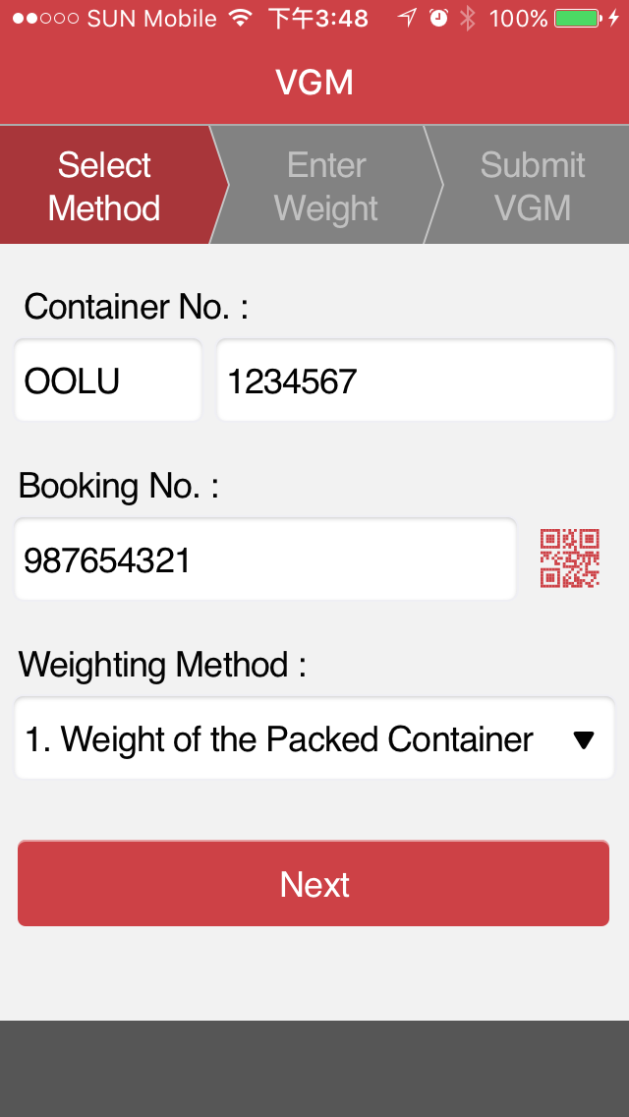
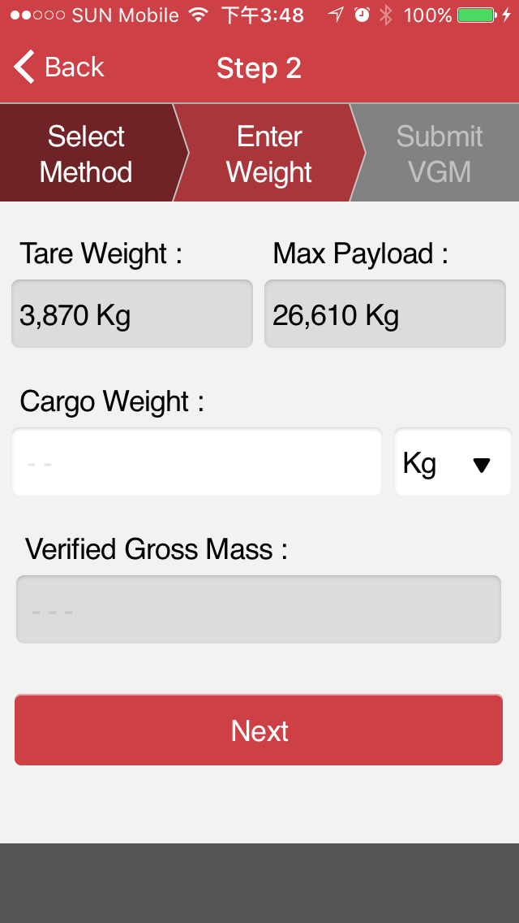
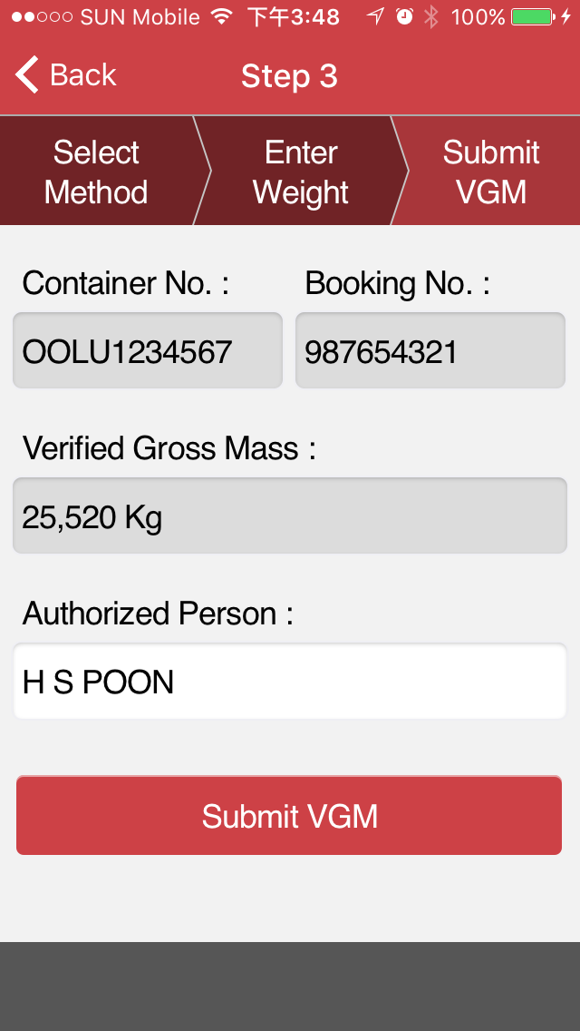


OOCL Lite – Submission

Slide 18
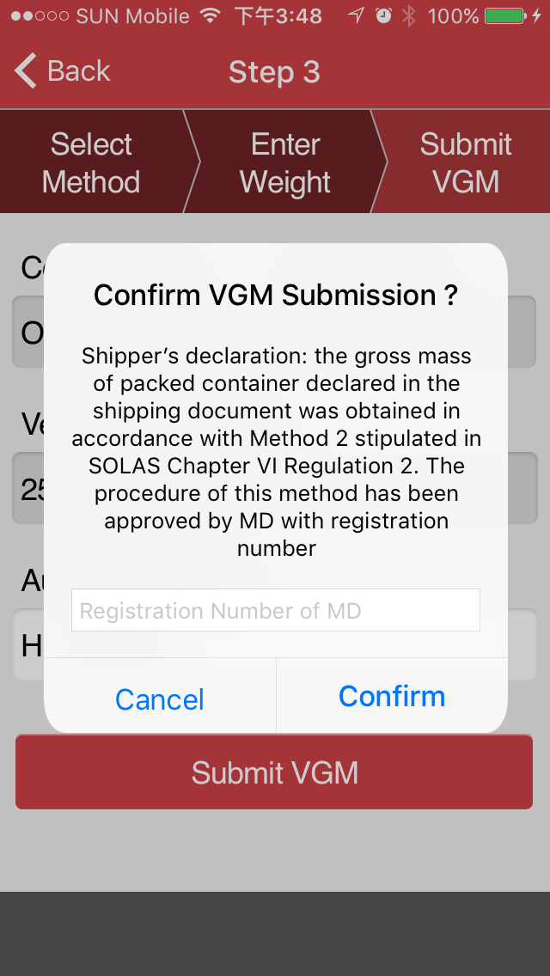
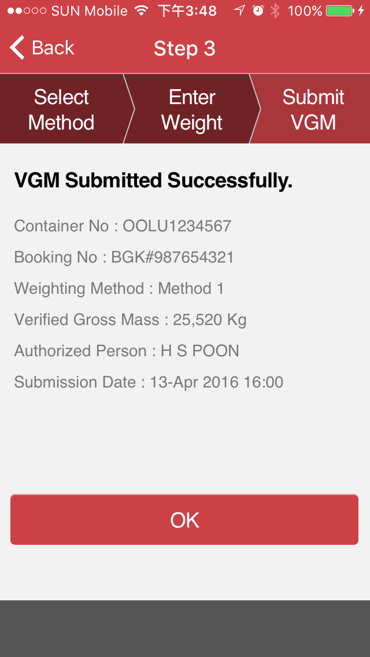
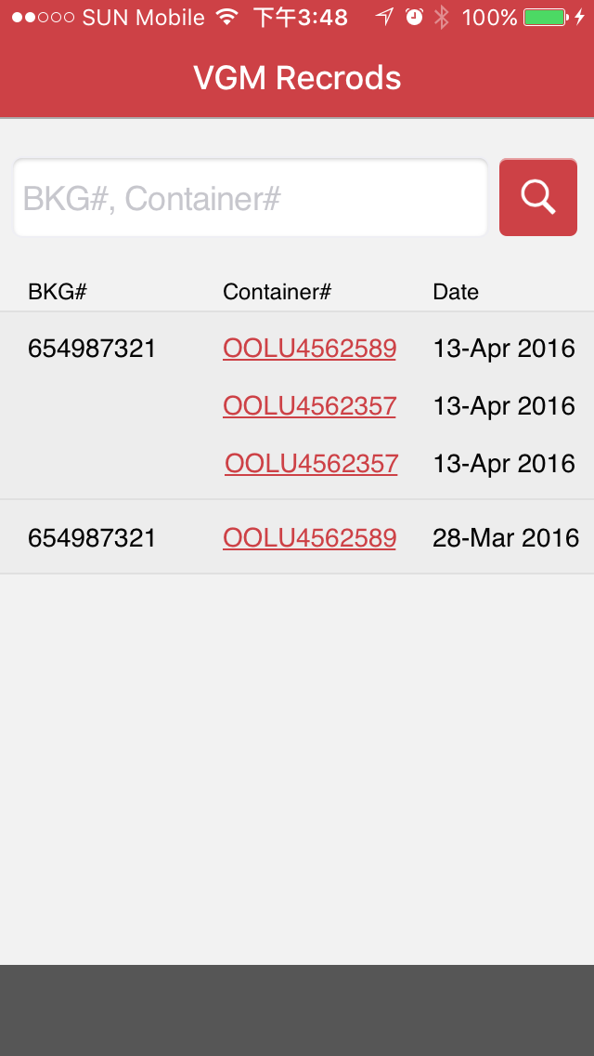
OOCL Lite – Submission and Records
Standard Declaration except
China, Hong Kong and UK
(derived by POL in booking)

Slide 19
EDI with our Customers
VGM Submission (VERMAS) - Preferred
  PROS: Independent of Shipping Instruction, Minimal Required Data
  CONS: Need to develop a new message
Shipping Instruction (IFTMIN / 304)
  PROS: Re-use current setup with minimal development effort
  CONS: Need to complete whole SI before submitting the VGM
Connection
  Direct – Preferred
  Via Portal – CargoSmart, GTNexus

Slide 20
The End

