Slide 1

My OOCL Center Intermodal Rail Pick Up Number Availability

Slide 2
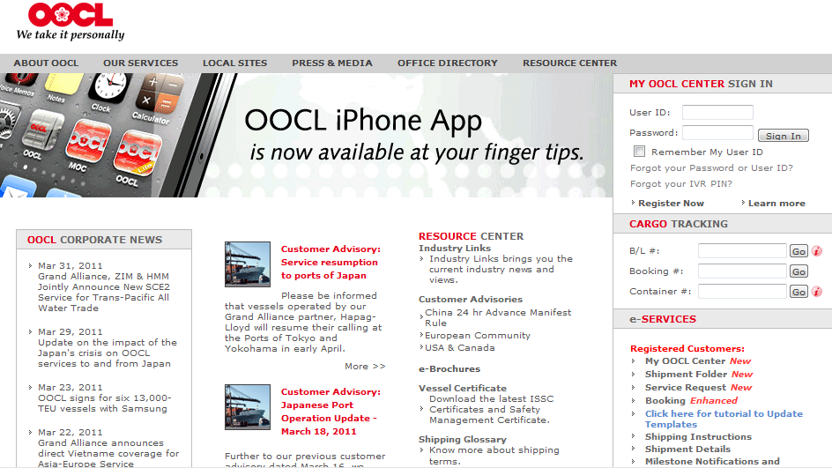
User ID
password
By signing in to My OOCL Center on oocl.com you can utilize several on line import Shipment Detail features, including obtaining your container and cargo Intermodal Rail Pick Up Number(s).
To begin, type in your user ID and password. If you do not have one, click Register Now.

Slide 3
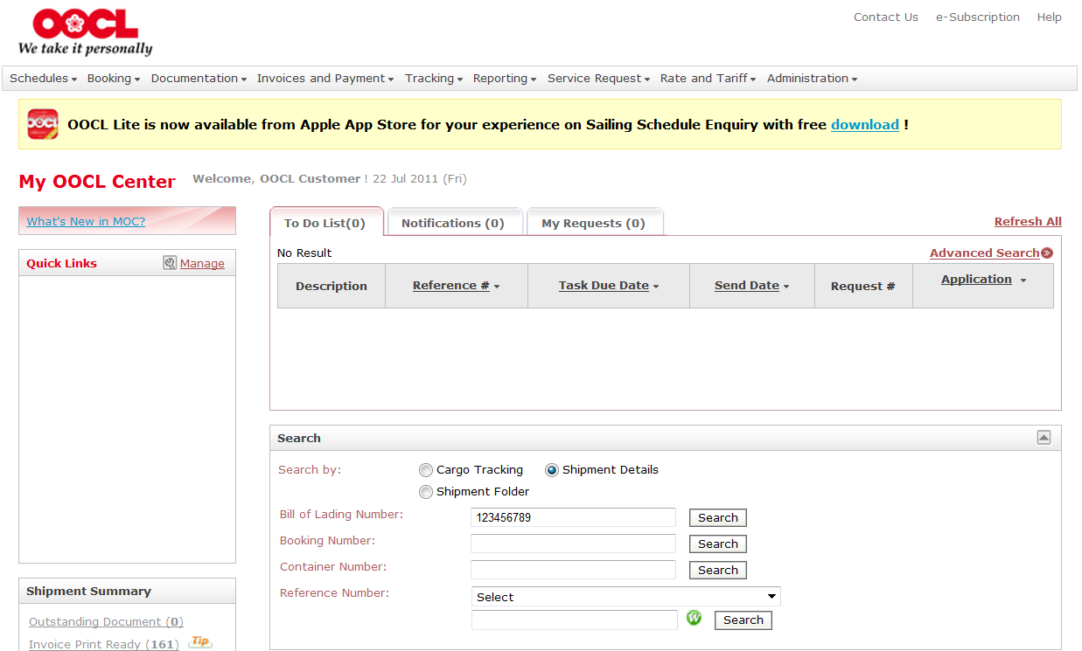
After logging into My OOCL Center, under the Search feature, select Shipment Details.
Enter your import Bill of Lading Number, then click Search.

Slide 4
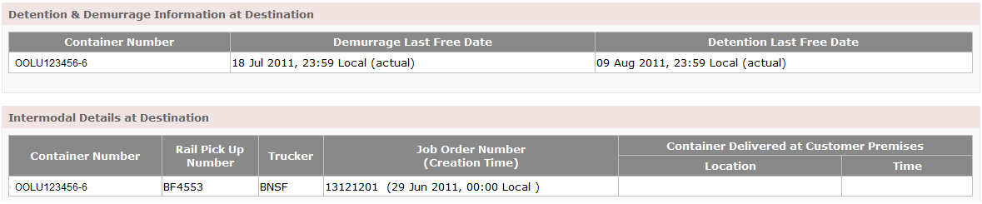
The intermodal rail pick up number will be located towards the bottom of the Shipment
Details screen under “Intermodal Details at Destination”.
*Please note in order for your intermodal rail pick up number to be available in My
OOCL Center, your OOCL import bill of lading must be completely released (e.g. Customs
cleared, all Collect Freight Charges paid, and Original Bills of Lading surrendered)

Slide 5
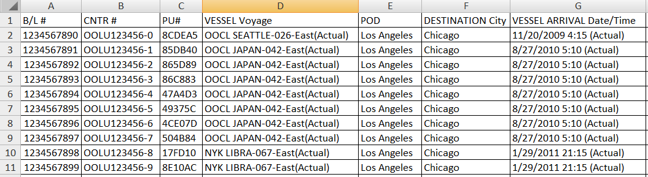
You also have the ability to receive an automated report which would include your
container and cargo’s intermodal rail pick up numbers (as shown below).
For customers with multiple containers, the report option is an efficient way to obtain
intermodal rail pick up number information.
Additional report fields can be added to provide other tracking information (e.g.
Cargo Release Status, Tracking and Arrival at Destination, Demurrage Free time).

Slide 6
For additional information concerning My OOCL Center intermodal rail pick up number information, please reference the help feature in My OOCL Center (www.oocl.com). For additional questions please contact OOCL Customer Service Center at 1-888-388-OOCL.

